Slide 1
Lecture-11
Distinguish between the types of problems that humans do best and those that computers do best
Explain the Turing test
Explain the processing of an expert system
Explain the processing of biological and artificial neural networks

Slide 2
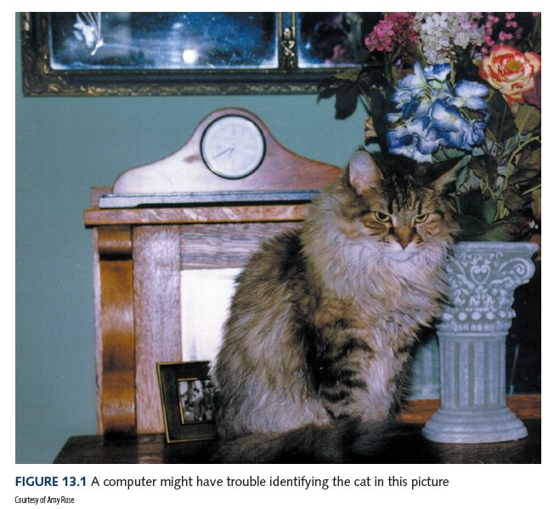
Thinking Machines
Can you
list the items
in this
picture?

Slide 3

Thinking Machines
Can you count
the distribution
of letters in a
book?
Add a thousand
4-digit numbers?
Match finger
prints?
Search a list of
a million values
for duplicates?

Slide 4
Thinking Machines
Computers do best
Humans do best
Can you count the
distribution of letters in
a book?
Add a thousand4-digit
numbers?
Match finger prints?
Search a list of a
million values
for duplicates?
Can you
list the items
in this
picture?

Slide 5
Thinking Machines
Artificial intelligence (AI)
The study of computer systems that attempt to model and apply the intelligence of the human mind
For example, writing a program to pick out objects in a picture

Slide 6
The Turing Test
Turing test
A test to empirically determine whether a computer has achieved intelligence
Alan Turing
An English mathematician who wrote a landmark paper in 1950 that asked the question: Can machines think? He proposed a test to answer the question "How will we know when we’ve succeeded?"

Slide 7
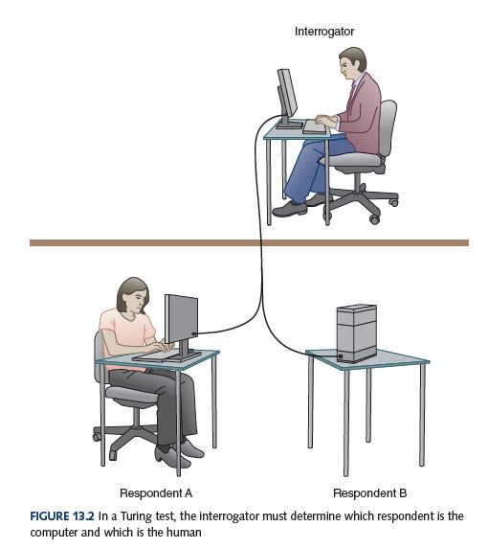
The Turing Test

Slide 8
The Turing Test
Weak equivalence
Two systems (human and computer) are equivalent in results (output), but they do not arrive at those results in the same way
Strong equivalence
Two systems (human and computer) use the same internal processes to produce results

Slide 9
The Turing Test
Loebner prize
The first formal instantiation of the Turing test, held annually
Has it been
won yet?

Slide 10
Expert Systems
Knowledge-based system
Software that uses a specific set of information, from which it extracts and processes particular pieces
Expert system
A software system based on the knowledge of human experts; it is a
Rule-based system A software system based on a set of if-then rules
Inference engine The software that processes rules to draw conclusions

Slide 11
Expert Systems
Boolean variables needed to represent state of the lawn
BARE—the lawn has large, bare areas
SPARSE—the lawn is generally thin
WEEDS—the lawn contains many weeds
BUGS—the lawn shows evidence of bugs

Slide 12
Expert Systems
Some rules
if (CURRENT – LAST < 30) then NONE
if (SEASON = winter) then not BUGS
if (CLOUDS and not SUNNY) then RAIN

Slide 13
Expert Systems
An execution of our inference engine
System: Does the lawn have large, bare areas?
User: No
System: Does the lawn show evidence of bugs?
User: No
System: Is the lawn generally thin?
User: Yes
System: Does the lawn contain significant weeds?
User: Yes
System: You should apply a weed-killing and fertilizer combination treatment.

Slide 14
Artificial Neural Network
Artificial neural networks
A computer representation of knowledge that attempts to mimic the neural networks of the human body
Yes, but what is a human neural network?

Slide 15
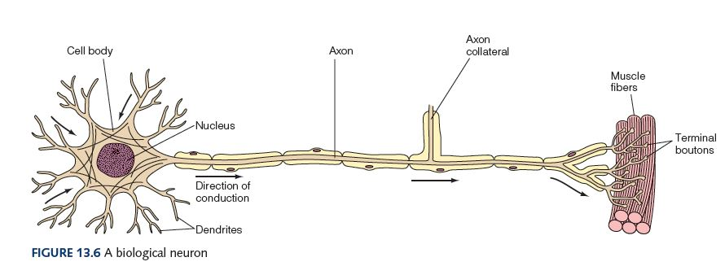
Artificial Neural Network

Slide 16
Artificial Neural Network
Neuron
A single cell that conducts a chemically-based electronic signal
At any point in time a neuron is in either an excited state or an inhibited state
Excited state
Neuron conducts a strong signal
Inhibited state
Neuron conducts a weak signal

Slide 17
Artificial Neural Network
Pathway
A series of connected neurons
Dendrites
Input tentacles
Axon
Primary output tentacle

Slide 18
Artificial Neural Network
The pathways along the neural nets are in a constant state of flux
As we learn new things, new strong neural pathways in our brain are formed

Slide 19
Artificial Neural Network
Each processing element in an artificial neural net is analogous to a biological neuron
An element accepts a certain number of input values (dendrites) and produces a single output value (axon) of either 0 or 1
Associated with each input value is a numeric weight

Slide 20
Artificial Neural Network
The effective weight of the element is the sum of the weights multiplied by their respective input values
v1 * w1 + v2 * w2 + v3 * w3
Each element has a numeric threshold value
If the effective weight exceeds the threshold, the unit produces an output value of 1
If it does not exceed the threshold, it produces an output value of 0

Slide 21
Artificial Neural Network
Training
The process of adjusting the weights and threshold values in a neural net
How does this all work?
Train a neural net to recognize a cat in a picture
Given one output value per pixel, train network to produce an output value of 1 for every pixel that contributes to the cat and 0 for every one that doesn't

Slide 22
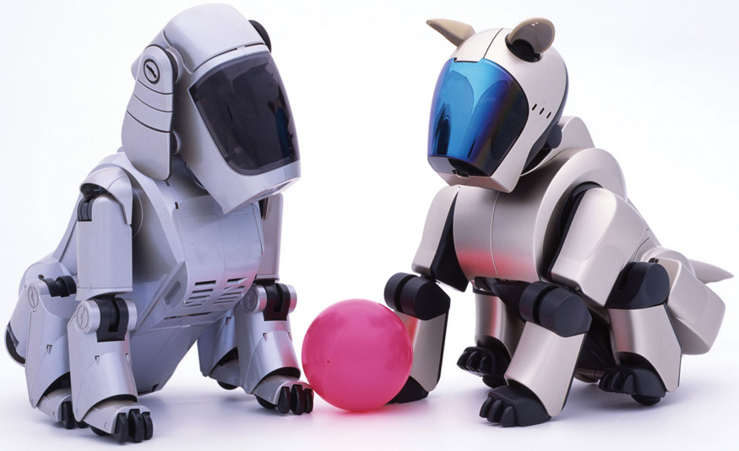
Robots

Slide 23
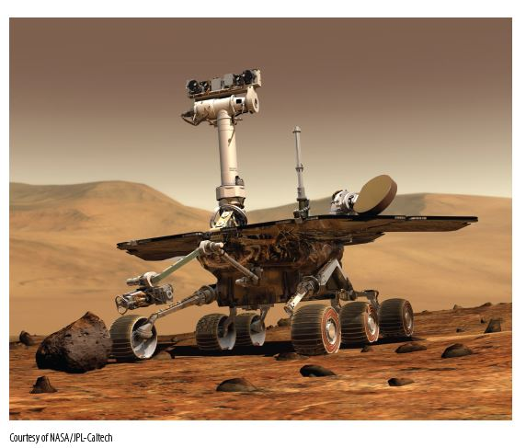
Robots

